Slide 1
UNIT I
Introduction to Software Engineering

Slide 2
Introduction to Software Engineering
Objectives
Principles
Practices

Slide 3
Introduction
Software Engineering is the subdiscipline of Computer Science that attempts to apply engineering principles to the develop, operation, modication and maintenance of the software components of various computing systems.

Slide 4
Software Engineering
What is it?
Who does it?
Why it is important ?
What are the steps ?
What are the work products ?
How do I ensure that I have done it right?

Slide 5
THE NATURE OF SOFTWARE
Why does it take so long to get software finished?
Why are development costs so high?
Why can’t we fi nd all errors before we give the software to our customers?
Why do we spend so much time and effort maintaining existing programs?
Why do we continue to have diffi culty in measuring progress as software is being developed and maintained?

Slide 6
Defining Software
Software is:
(1) instructions (computer programs) that when executed provide desired features, function, and performance;
(2) data structures that enable the programs to adequately manipulate information, and
(3) descriptive information in both hard copy and virtual forms that describes the operation and use of the programs.

Slide 7
Software Application Domains
System software,
Application software,
Engineering/scientic software,
Embedded software,
Product-line software,
Web applications,
Articial intelligence software

Slide 8
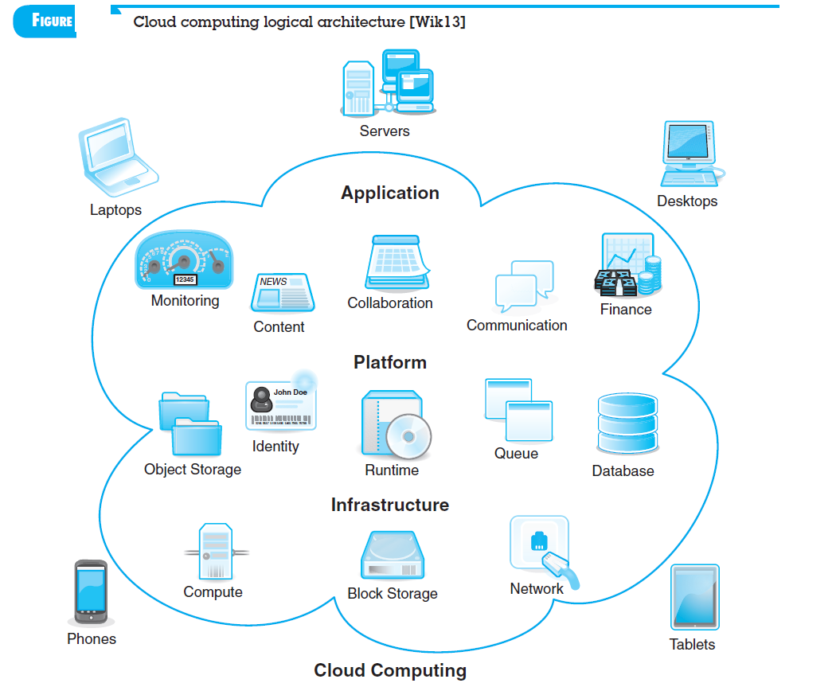

Slide 9
DEFINING THE DISCIPLINE
The IEEE has developed the following defi nition for software engineering:
Software Engineering :
  (1) The application of a systematic, disciplined, quantifiable approach to the development, operation, and maintenance of software; that is, the application of engineering to software.
(2) The study of approaches as in (1).

Slide 10
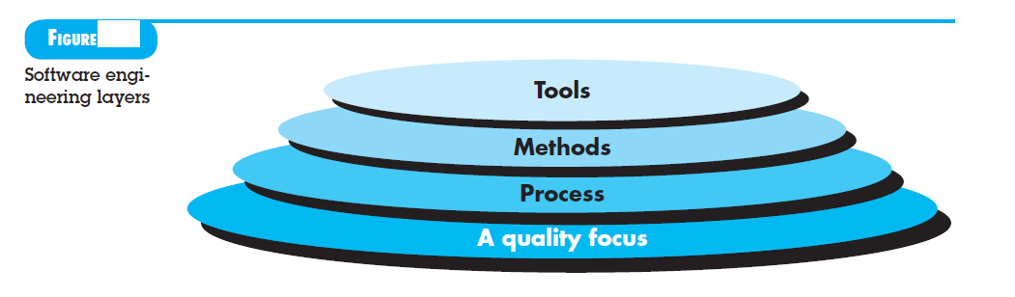
SE layers

Slide 11
Objective of SE
1. Maintainability – the ease with which changes in a functional unit can be performed in order to meet prescribed requirements.
2. Correctness – the extent to which software meets its specified requirements
3. Reuseability – the extent to which a module can be used in multiple applications.

Slide 12
Objective of SE
4. Testability – the extent to which software facilitates both the establishment of test criteria and the evaluation of the software with respect to those criteria.
5. Reliability – an attribute of software quality. The extent to which a program can be expected to perform its intended function, over an arbitrary time period.

Slide 13
Objective of SE
6. Portability – the ease with which software can be transferred from one computer system or environment to another.
7. Adaptability – the ease with which software allows differing system constraints and user needs to be satisfied by making changes to the software.

Slide 14
Principles
Software Engineering Principle
  A tool or methodology employed to assist software developers in reaching the objectives of software engineering.
Examples –
  Modularity –
  Hierarchical Decomposition –
  Functional Decomposition –
Information Hiding

Slide 15
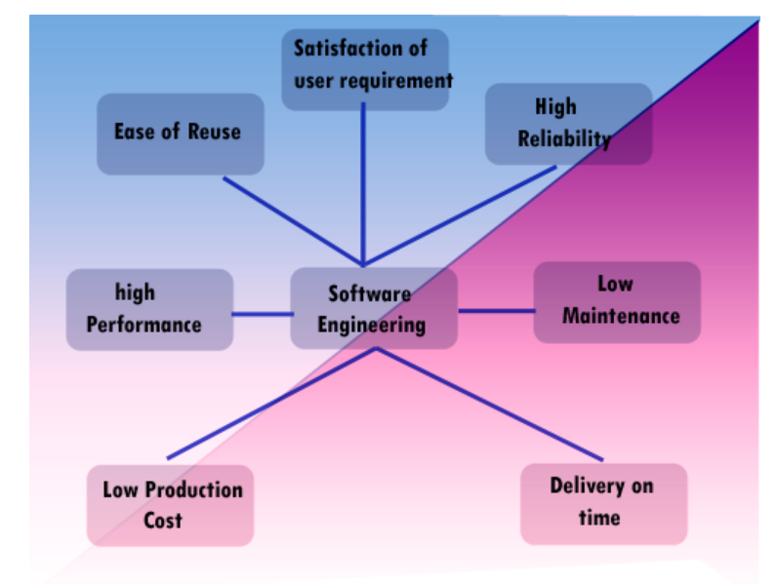
SE Practices

Slide 16
SE practice
Understand the problem (communication and analysis).
Plan a solution (modeling and software design).
Carry out the plan (code generation).
Examine the result for accuracy (testing and quality assurance).

Slide 17
SE practice
Seven principles that focus on software engineering practice -
Reason,
Simple,
Vision,
Produce & Consume,
Future,
Resuse,
Think.

